Slide 1

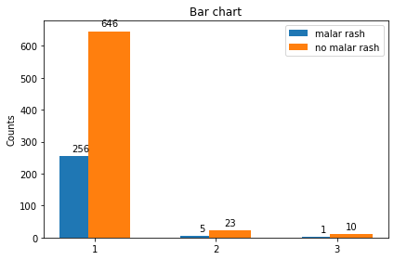
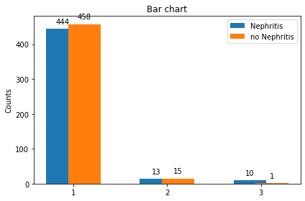
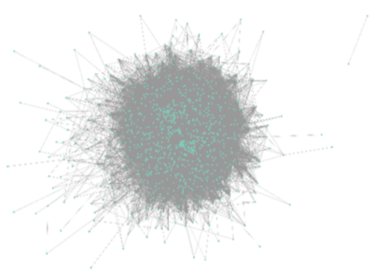
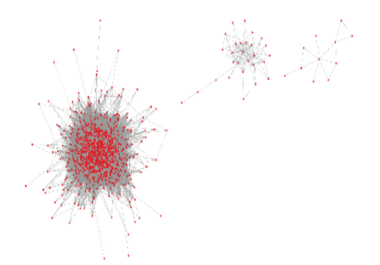
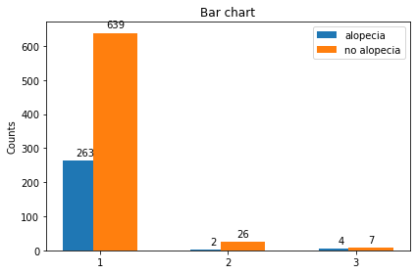
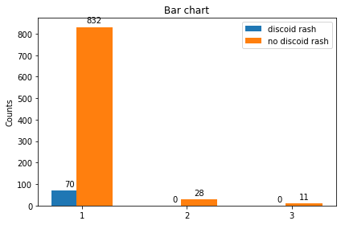
Correlation Network and Population Analysis for SLE Patients Health Monitoring
Sultan Qaboos University
Collage of Science
Department of Computer Science
Done By: Ahmed Salim Al-Abri, Mohammed Said Al-Abri
Supervised By: Dr. Hamza Zidoum
Introduction
Processes
Figure 6 count how many SLE patients have nephritis and how many do not have nephritis in each cluster. We see that in clusters 1 and 2, the number of non-nephritis patients with SLE is slightly higher than the number of patients with nephritis, while in cluster 3, the number of people with nephritis among SLE patients is much higher than the number of those without nephritis.
SLE is a multi-systemic autoimmune disease associated with considerable morbidity and mortality. It is a challenge to Oman health system ; the mean prevalence of SLE among different age groups is 38.8 (range 5-63 per 100 000 inhabitants), and the mortality rate was found to be 5%. Our main objective is to use data for patient representation and discovery which involves analyzing the data features to identify patterns in the population such as sub-groups. In particular, we conducted a study to investigate how Correlation Network analysis combined with Machine Learning technique can help identifying, visualizing and monitoring SLE patients sub-groups.
After we finished studying the data from SLE patients, we moved on to the next step, which was data preparation. We completed the data cleaning and encoding process in this step. Then, using SLE data, we constructed a correlation network. We create the correlation matrix in Python using the spearman correlation measure and then upload it to the cystoscope (see figure 1).
Figure 4 count how many SLE patients have a malar rash and how many do not have a malar rash in each cluster, we see from all clusters that most SLE patients do not have a malar rash.
EHR
The next step is to make the MCL algorithm for the correlation network. Figure (2) presents the top 3 cluster (red coloured cluster) generated by MCL algorithm. Table 1 (comparison between three clusters) shows us the statistics of these 3 clusters, first cluster have the heights number of nodes, with 902 nodes and 105298 edges. The smallest cluster have only 11 nodes and 14 edges.
Finally, we conducted a cluster comparison to determine the similarities and differences between the clusters. We selected some SLE data features and compared them in one cluster to the same feature in the other clusters.
Clinical
Demographic
Lab
Feature Selection
Patients
Features
Figure 1: Correlation Network Model
Dataset
The main objective of this project is to employ the Markov clustering algorithm after using a correlation network to analyse a dataset of SLE patient data. We use the generated clusters to find similarities and dissimilarities between clusters.
At the beginning of our project, we studied the data of SLE patients, where we made a search for the main features in the data set of SLE patients, and then we made some statistics for the data. Here are some stats:
1161 SLE patients.
The dataset contains demographic, clinical, and laboratory data.
The majority of the patients were between the ages of 32 and 36. And the lowest age range of patients was 60 and up.
the female is a most patient gender in dataset since represent 88%.
Figure 4: Malar rash
Figure 2: Markov Clustering
Figure 6 : Nephritis
Figure 5 count how many SLE patients have alopecia and how many do not have alopecia in each cluster, we see from all clusters that most SLE patients do not have an alopecia rash.
Conclusion and future work:
In this project, we used most known clustering algorithm which MCL to identify several cluster, from these clusters we find some patterns that may help to decrease the spread of disease. The future work:
Find model that can inspect the degree of disease in given patients
Try to maximize the dataset to include all hospitals in Oman.
Create program to simplify usage for doctors
Figure: The process of analysis of EHR data for discovery and monitoring.
Results
Figure 3 count how many SLE patients have a discoid rash and how many do not have a discoid rash in each cluster, we see from all clusters that most SLE patients do not have a discoid rash.
Table 1: Network Statistics of top 3 cluster produced by the MCL Algorithm.
References
 | #Node | #Edge | Avg. degree | Network density | Clustering coefficient
1 | 902 | 105298 | 233.5 | 0.259 | 0.675
2 | 28 | 105 | 7.5 | 0.278 | 0.658
3 | 11 | 14 | 2.545 | 0.255 | 0.498
[1] Geron, A. (2019). Hands-on machine learning with Scikit-Learn, Keras and TensorFlow: concepts, tools, and techniques to build intelligent systems (2nd ed.). O’Reilly.
[2] Chetti, P. and Ali, H. (2020). Estimating the Inspection Frequencies of Civil Infrastructures using Correlation Networks and Population Analysis.
[3] Shannon, P., Markiel, A., Ozier, O., Baliga, N. S., Wang, J. T., Ramage, D., ... & Ideker, T. (2003). Cytoscape: a software environment for integrated models of biomolecular interaction networks. Genome research, 13(11), 2498-2504.
Figure 5: Alopecia
Figure 3: Discoid rash

